Slide 1
Machine Learning Adaptation
Presented by:
Jayson Backes Statistician XVII

Slide 2
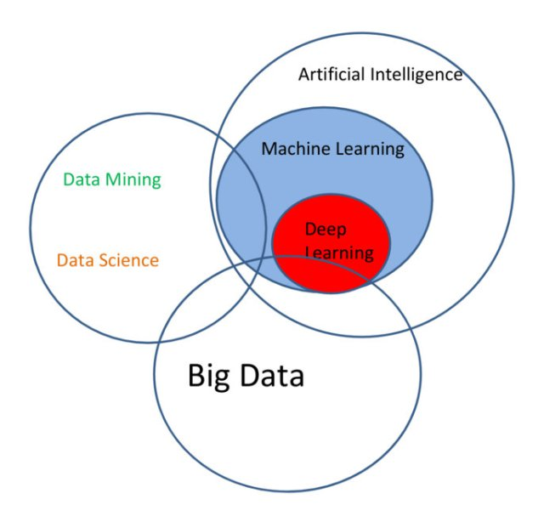
Machine Learning
Machine learning is an application of artificial intelligence (AI) that provides systems the ability to automatically learn and improve from experience without being explicitly programmed. Machine learning focuses on the development of computer programs that can access data and use it learn for themselves.¹
1. http://www.expertsystem.com/machine-learning-definition/

Slide 3
The Problem
Name | Address | Owner | License | Status
(DBA) Amber Noullet, LMT | 895 Kyker Ferry Rd | Amber D. Noullet | 00003912 | Licensed
(Metroplex) Onsite Massage Inc. | 490 Metroplex Drive HCA | 00004820 | Licensed
AT PEACE THERAPEUTIC MASSAGE | 8 CROUCH COURT | ELIZABETH TURNBULL | 00004050 | Licensed
1 of a Kind Massage | 122 Lee Parkway Suite 203 | 00004522 | Licensed
100% Chiropractic | 2805 Old Fort Pkwy Suite D | 00004605 | Licensed
3R Massage Therapy | 2102 Forest Drive Suite #3 | MARCIA AICHEL | 00003599 | Licensed
A A FOOT SPA | 224 THOMPSON LANE #B | Bing Wei Liu | 00004218 | Licensed
A Affordable Rehab & Massage | 119 Racine 200 A | 00004457 | Licensed
A GLIMMER OF HOPE | 130 EAST WASHINGTON AVENUE | LORI MARIN WILLIAMS | 00004120 | Licensed
A Great Massage | 875 West Poplar Avenue #8 | JUANHONG CHEN | 00004272 | Licensed
A Great Massage | 5101 Sanderlin Avenue Suite 101 | 00004314 | Licensed
A HEALING PLACE MASSAGE | 2531 PARK DRIVE SUITE A | Gwen Hopkins | 00002423 | Licensed
A Healing Touch Massage | 1129 Trotwood Avenue Suite 12 | 00004598 | Licensed

Slide 4
Iris Flower Dataset
Iris-virginica | Iris-versicolor | Iris-setosa
Observation | Observation | Observation
Observation 1
class | sepal-width | petal-length | petal-width | sepal-length
Iris-virginica | 3.4 | 5.4 | 2.3 | 6.2
Iris-versicolor | 3.1 | 4.7 | 1.5 | 6.7
Iris-setosa | 3.4 | 1.7 | 0.2 | 5.4

Slide 5
Title
Name | Address | Owner | License | Status
(DBA) Amber Noullet, LMT | 895 Kyker Ferry Rd | Amber D. Noullet | 00003912 | Licensed
Observation 1
Class | Observation Length | # of Characters | # of Digits | # of Symbols | # of Words
Name | 24 | 18 | 0 | 3 | 4
Address | 18 | 12 | 3 | 0 | 4
Owner | 16 | 13 | 0 | 1 | 3
License | 8 | 0 | 8 | 0 | 1
Status | 8 | 8 | 0 | 0 | 1
Values transformed into feature vectors

Slide 6
Creating Feature Vectors
Each column has a collection of values with features
We can treat each observation as our X values and the column number as our Y value
 | Y | X₁ | X₂ | X₃ | X₄ | X₅
obs | class | len | char | num | sym | words
1 | col1 | 18 | 16 | 0 | 0 | 3
2 | col1 | 18 | 16 | 0 | 0 | 3
3 | col1 | 27 | 23 | 0 | 0 | 5
4 | col2 | 26 | 19 | 3 | 0 | 4
5 | col2 | 17 | 11 | 3 | 0 | 3
6 | col2 | 28 | 16 | 7 | 0 | 5
7 | col3 | 16 | 13 | 0 | 1 | 3
8 | col3 | 11 | 10 | 0 | 0 | 2
9 | col3 | 14 | 13 | 0 | 0 | 2
10 | col4 | 8 | 0 | 8 | 0 | 1
11 | col4 | 8 | 0 | 8 | 0 | 1
12 | col4 | 8 | 0 | 8 | 0 | 1
13 | col5 | 8 | 8 | 0 | 0 | 1
14 | col5 | 8 | 8 | 0 | 0 | 1
15 | col5 | 8 | 8 | 0 | 0 | 1

Slide 7
Machine Learning on the Iris Dataset
First split the dataset
  80% training
  20% validation
Run 6 models
  Logistic Regression
  Liner Discriminate Analysis
  K-nearest Neighbor
  Decision Tree Classifier
  Native Bayes
  Support Vector
Kfold cross validation
  N=10

Slide 8
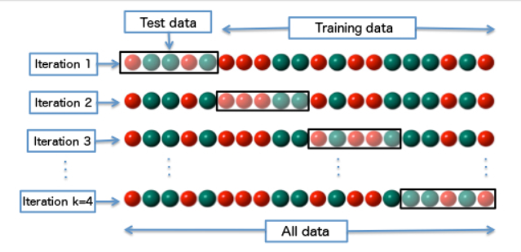

Split the dataset 80/20
When we train the model we will use 80% of the observation, while leaving 20% (observations unknown to the ‘machine’) to be used for validation of the model .
We will use cross validation on the 80% of data to estimate the mean accuracy of each of the 6 models to find the best model.
  Below is an example of kfold cross validation with 4 folds. The dataset is randomly divided into k number of parts and k-1 is used for the training data with the rest as the validation data. This is done k number of times. For our model we use k = 10
The 80% Training Set
The 20% Validation Set

Slide 9
Cross Validation Results
These are the results for the 6 model run on our data
The Support Vector and K-nearest Neighbor were the two best models
The numbers represent the average percent accuracy and average standard deviation for each of the kfold cross validation.
Fold | Accuracy
Kfold 1 | 1.00000
Kfold 2 | 1.00000
Kfold 3 | 0.91667
Kfold 4 | 1.00000
Kfold 5 | 1.00000
Kfold 6 | 1.00000
Kfold 7 | 0.91667
Kfold 8 | 0.91667
Kfold 9 | 0.91667
Kfold 10 | 1.00000
Average | 0.96667
Model | Mean | Std
SVM | 0.991667 | -0.025000
NB | 0.975000 | -0.053359
LR | 0.966667 | -0.040825
CART | 0.966667 | -0.040825
KNN | 0.983333 | -0.033333
LDA | 0.975000 | -0.038188

Slide 10
Model validation
After choosing the model we want, we train on the 80% training dataset
Once the model is trained, we want to test the model on the 20% dataset
  Results below show how well the model fit new (validation) data
Precision = number of correct positive results divided by the number of all positive results
Recall = number of correct positive results divided by the number of positive results that should have been returned
F1 = Harmonic average of Precision and Recall
  F1 = 2 * (precision * recall) / (precision + recall)
 | precision | recall | f1-score | support
Iris-setosa | 1.00 | 1.00 | 1.00 | 7
Iris-versicolor | 1.00 | 0.83 | 0.91 | 12
Iris-virginica | 0.85 | 1.00 | 0.92 | 11
Average | 0.94 | 0.93 | 0.93

Slide 11
Predicting class
Now that we have a trained model, we can use it to predict new observation
sepal-length | sepal-width | petal-length | petal-width | actual | predicted
4.40 | 2.90 | 1.40 | 0.20 | Iris-setosa | Iris-setosa
6.60 | 2.90 | 4.60 | 1.30 | Iris-versicolor | Iris-versicolor
4.70 | 3.20 | 1.30 | 0.20 | Iris-setosa | Iris-setosa
5.40 | 3.40 | 1.50 | 0.40 | Iris-setosa | Iris-setosa
5.40 | 3.00 | 4.50 | 1.50 | Iris-versicolor | Iris-versicolor
5.10 | 2.50 | 3.00 | 1.10 | Iris-versicolor | Iris-versicolor
5.60 | 2.50 | 3.90 | 1.10 | Iris-versicolor | Iris-versicolor
7.30 | 2.90 | 6.30 | 1.80 | Iris-virginica | Iris-virginica
6.30 | 2.30 | 4.40 | 1.30 | Iris-versicolor | Iris-versicolor
5.80 | 4.00 | 1.20 | 0.20 | Iris-setosa | Iris-setosa

Slide 12
Predicting class
Now that we have a trained model, we can use it to predict new observation
sepal-length | sepal-width | petal-length | petal-width | actual | predicted
4.40 | 2.90 | 1.40 | 0.20 | Iris-setosa | Iris-setosa
6.60 | 2.90 | 4.60 | 1.30 | Iris-versicolor | Iris-versicolor
4.70 | 3.20 | 1.30 | 0.20 | Iris-setosa | Iris-setosa
5.40 | 3.40 | 1.50 | 0.40 | Iris-setosa | Iris-setosa
5.40 | 3.00 | 4.50 | 1.50 | Iris-versicolor | Iris-versicolor
5.10 | 2.50 | 3.00 | 1.10 | Iris-versicolor | Iris-versicolor
5.60 | 2.50 | 3.90 | 1.10 | Iris-versicolor | Iris-versicolor
7.30 | 2.90 | 6.30 | 1.80 | Iris-virginica | Iris-virginica
6.30 | 2.30 | 4.40 | 1.30 | Iris-versicolor | Iris-versicolor
5.80 | 4.00 | 1.20 | 0.20 | Iris-setosa | Iris-setosa

Slide 13
Back to the columns problem
If we treat the column number as the ‘class’, and train the data using features of each of the observations, we should be able to predict the group/column/class that an observation belongs.
We create a feature vector for each observation and treat the column number as the target (class)
Name | Address | Owner | License | Status
(DBA) Amber Noullet, LMT | 895 Kyker Ferry Rd | Amber D. Noullet | 00003912 | Licensed
Class | Observation Length | # of Characters | # of Digits | # of Symbols | # of Words
Name | 24 | 18 | 0 | 3 | 4
Address | 18 | 12 | 3 | 0 | 4
Owner | 16 | 13 | 0 | 1 | 3
License | 8 | 0 | 8 | 0 | 1
Status | 8 | 8 | 0 | 0 | 1

Slide 14
Our prediction is going to be really easy and because of two things
  We know which observation are wrong
  We only need to know which target (column) has the first occurrence of high error rate
We can separate our dataset in two
  Training (all observation are known to be correct)
  Validation (all observation are known to have incorrect data)
If we train onthe correct dataset, and test on the incorrect dataset, high error rates will show up where the data is wrong. That is, the predicted target/column for data that contains the shifted (wrong) datatype will have high error.

Slide 15
Name | Address | Owner | License | Status
(DBA) Amber Noullet, LMT | 895 Kyker Ferry Rd | Amber D. Noullet | 00003912 | Licensed
AT PEACE THERAPEUTIC MASSAGE | 8 CROUCH COURT | ELIZABETH TURNBULL | 00004050 | Licensed
3R Massage Therapy | 2102 Forest Drive Suite #3 | MARCIA AICHEL | 00003599 | Licensed
A A FOOT SPA | 224 THOMPSON LANE #B | Bing Wei Liu | 00004218 | Licensed
A GLIMMER OF HOPE | 130 EAST WASHINGTON AVENUE | LORI MARIN WILLIAMS | 00004120 | Licensed
A Great Massage | 875 West Poplar Avenue #8 | JUANHONG CHEN | 00004272 | Licensed
A HEALING PLACE MASSAGE | 2531 PARK DRIVE SUITE A | Gwen Hopkins | 00002423 | Licensed
Training Data
Low Error
Low Error
High Error
Name | Address | Owner | License | Status
(Metroplex) Onsite Massage Inc. | 490 Metroplex Drive HCA | 00004820 | Licensed
1 of a Kind Massage | 122 Lee Parkway Suite 203 | 00004522 | Licensed
100% Chiropractic | 2805 Old Fort Pkwy Suite D | 00004605 | Licensed
A Affordable Rehab & Massage | 119 Racine 200 A | 00004457 | Licensed
A Great Massage | 5101 Sanderlin Avenue Suite 101 | 00004314 | Licensed
A Healing Touch Massage | 1129 Trotwood Avenue Suite 12 | 00004598 | Licensed
Test Data

Slide 16
Model validation
The table below is the accuracy of using the trained (good) dataset and imposing it on the test (bad) dataset. The target column with low accuracy indicate where there are bad data
 | precision | recall | f1-score | support
Name | 0.42 | 0.74 | 0.54 | 492
Address | 0.99 | 1.00 | 0.99 | 496
Owner | 0.00 | 0.00 | 0.00 | 493
License | 0.00 | 0.00 | 0.00 | 497
Status | 0.00 | 0.00 | 0.00 | 497
Average | 0.28 | 0.35 | 0.31

Slide 17
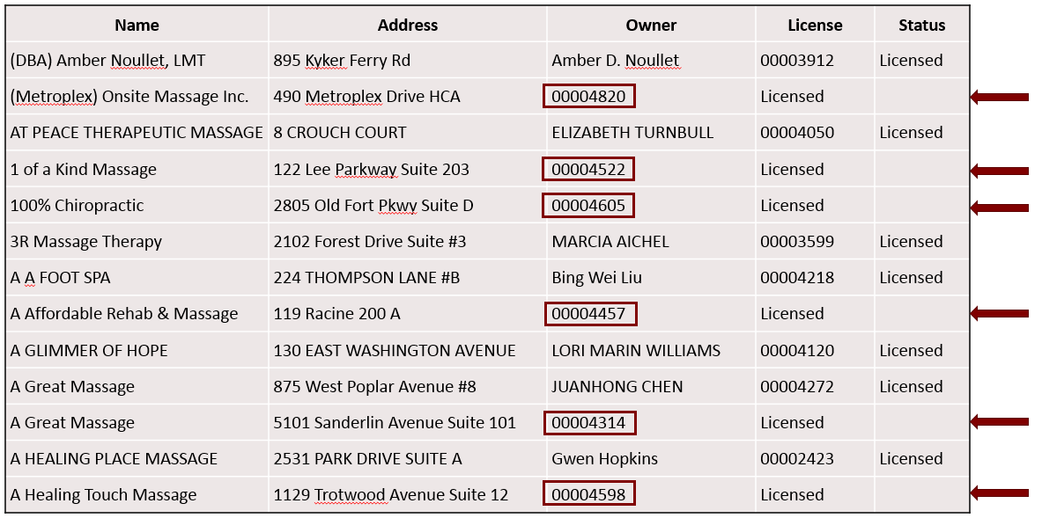
Title
We could try to predict in which column every observation falls, but that is not out main goal
Out main goal is to find the column in which our data contains the most anomalies
  In this case, we know the observation that are correct (the rows with all columns populated)

Slide 18
In Conculsion

Slide 19
Questions?
Jayson Backes Statistician XVIII
backesj@admedcorp.com
(615) 872-1723

